Slide 1
CSE101-Lec#6-Part-2
Control Structures[Repetition structures/ or Looping statements/ or Iterative statements]

Slide 2
Outline
Repetition structure/Control Loop Statements
for statement
while statement
do-while statement

Slide 3



Repetition(Going to School)
Day = Monday to Saturday

Slide 4
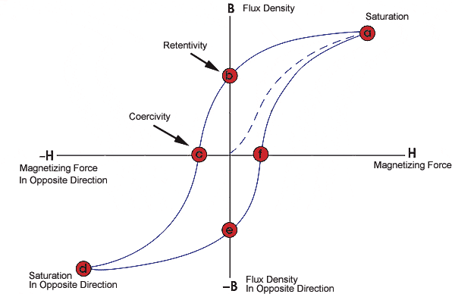
Repetition Statement
A repetition statement allows you to specify that an action is to be repeated while some condition remains true.

Slide 5
Looping (repetition)
What if we want to display hello 500 times?
Should we write 500 printf statements or equivalent ?
Obviously not.
It means that we need some programming facility to repeat certain works.
Such facility is available in form of looping statements.

Slide 6
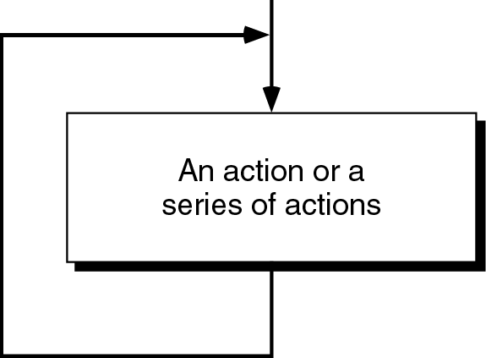
Loop
The main idea of a loop is to repeat an action or a series of actions.
The concept of a loop without condition

Slide 7
But, when to stop looping?
In the following flowchart, the action is executed over and over again. It never stops – This is called an infinite loop
Solution – put a condition to tell the loop either continue looping or stop.

Slide 8
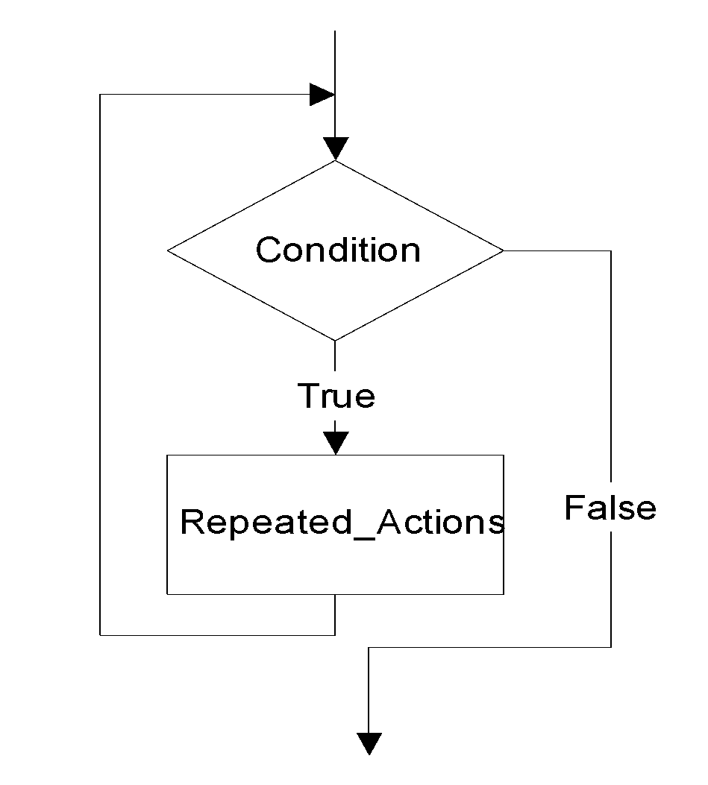
Loop
A loop has two parts – body and condition
Body – a statement or a block of statements that will be repeated.
Condition – is used to control the iteration – either to continue or stop iterating.

Slide 9
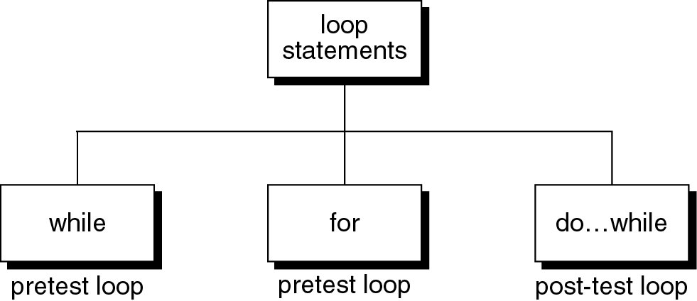
Loop statements
C provides three loop statements:

Slide 10
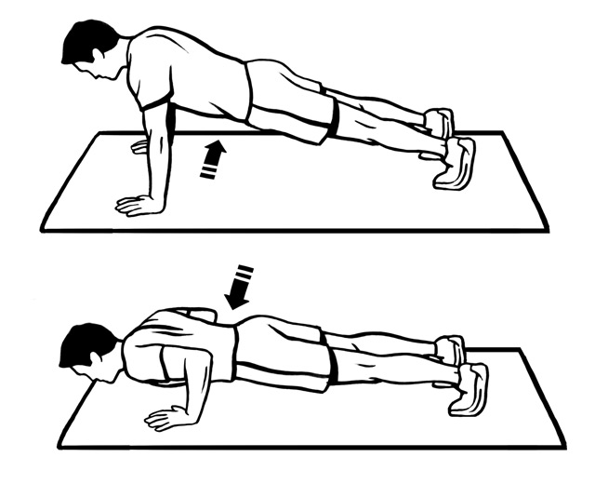
The “while” Statement in C
The syntax of while statement in C:
while (loop repetition condition){
statement;
updating control;
}
Syntax
While fatigue level is not reached

Slide 11
while statement
while(loop repetition condition)
{
Statements;
}
Loop repetition condition is the condition which controls the loop.
The statement is repeated as long as the loop repetition condition is true.
A loop is called an infinite loop if the loop repetition condition is always true.
while loop is known as entry controlled loop, as condition is checked at the beginning/ or entry point

Slide 12
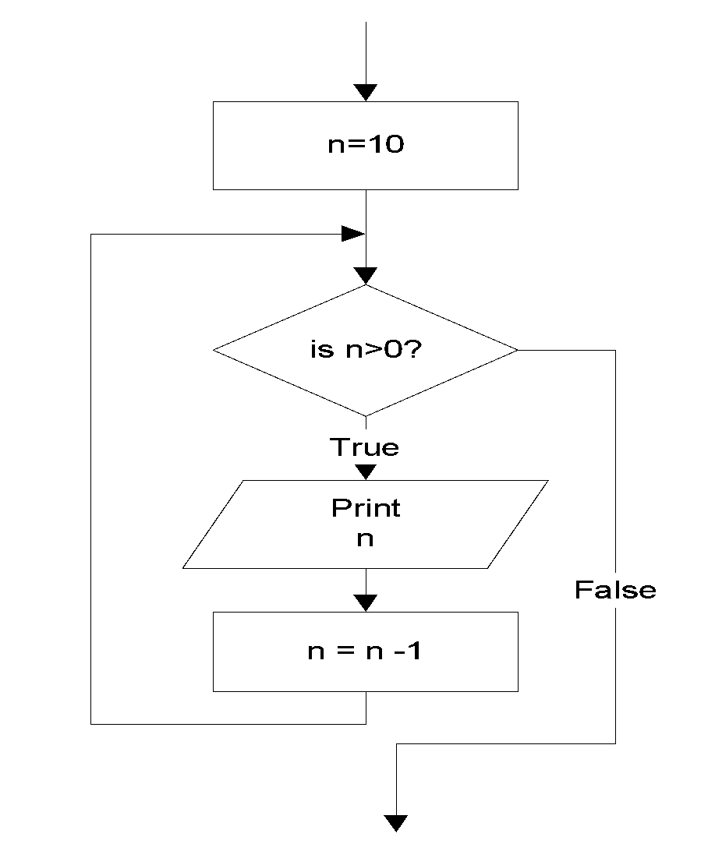
while statement
Example: This while statement prints numbers 10 down to 1
#include<stdio.h>
int main()
{
int n=10;
while (n>0){
printf(“%d ”, n);
n=n-1;
}
return 0;
}
10 9 8 7 6 5 4 3 2 1
Do TEN push ups imposes a count condition

Slide 13
Q1
How many times i value is checked in the following C code?
#include <stdio.h>
int main()
{
int i = 0;
while (i < 3)
i++;
printf("In while loop\n");
}
A. 2
B. 3
C. 4
D. 1
Notes:
C

Slide 14
Q2
What will be the output of the following C code?
#include <stdio.h>
int main()
{
int i = 0;
while (++i)
{
printf("H");
}
return 0;
}
A. H
B. H is printed infinite times
C. Compile time error
D. Nothing will be printed
Notes:
B

Slide 15
Q3
What will be the output of the following C code?
#include <stdio.h>
int main()
{
int i = 0;
while (i = 0)
printf("True\n");
printf("False\n");
return 0;
}
A. True (infinite time)
B. True (1 time) False
C. False
D. Compiler dependent
Notes:
C

Slide 16
Q4
What will be the output of the following C code?
#include <stdio.h>
int main()
{
int i = 0, j = 0;
while (i < 5, j < 10)
{
i++;
j++;
}
printf("%d, %d\n", i, j);
return 0;
}
A. 5, 5
B. 5, 10
C. 10, 10
D. Compiler error
Notes:
C

Slide 17
Q5
What will be the output of the following C code?
#include <stdio.h>
int main()
{
int i=0;
while(++i<=5);
printf("%d ",i);
return 0;
}
A. 1 2 3 4 5
B. 6
C. 5
D. Compiler error
Notes:
B

Slide 18
The for Statement in C
The syntax of for statement in C:
The initialization-expression set the initial value of the loop control variable.
The loop-repetition-condition test the value of the loop control variable.
The update-expression update the loop control variable.
It is also known as entry controlled loop as condition is checked first and then loop body executes
for (initialization-expression;
loop-repetition-condition;
update-expression){
statement;
}
Syntax

Slide 19
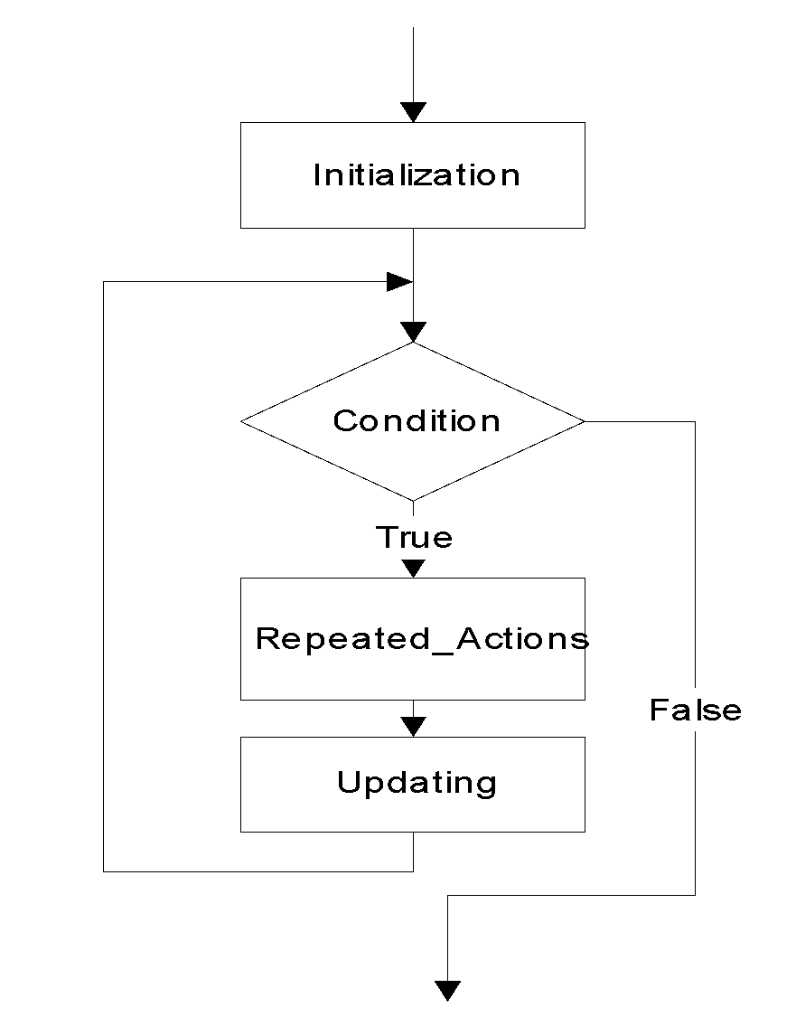
for statement
for (Initialization; Condition; Updating)
{
Repeated_Actions;
}

Slide 20

for statement
Example: This for statement prints numbers 10 down to 1
#include<stdio.h>
int main()
{
int n;
for (n=10; n>0; n=n-1){
printf(“%d ”, n);
}
return 0;
}
10 9 8 7 6 5 4 3 2 1
Do TEN push ups = for count=1; count<=10; count++

Slide 21
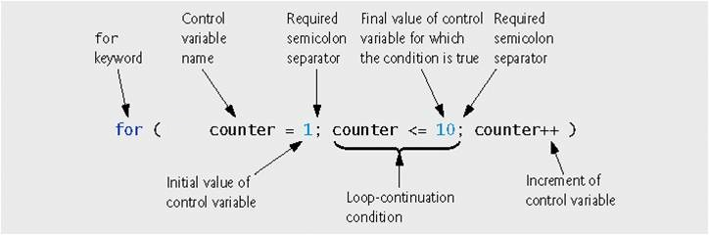

Slide 22
Q1
#include <stdio.h>
int main()
{
int i;
for (i = 1; i != 10; i += 2)
printf("Hello");
return 0;
}
A. Hello will be displayed 5 times
B. Hello will be displayed 4 times
C. Hello will be displayed infinite no. of times
D. Hello will be displayed 6 times
Notes:
C

Slide 23
Q2
What will be the output of following code
#include<stdio.h>
int main()
{
int i;
for(i=1;i<10;i++);
printf("%d",i);
return 0;
}
Numbers from 1 to 9 will be printed
10
9
Infinite loop
Notes:
B

Slide 24
Q3
What will be the output of following code?
#include<stdio.h>
int main()
{
int i;
for(i=2;i<=10;)
{
printf("%d ",++i);
}
return 0;
}
A. 2 3 4 5 6 7 8 9 10
B. 3 4 5 6 7 8 9 10 11
C. infinite loop
D. Compile time error
Notes:
B

Slide 25
Q4
What will be the output of following code?
#include<stdio.h>
int main()
{
int i=1;
for(;0;)
{
printf("%d",i);
i++;
}
return 0;
}
A. 1
B. 0
C. infinite loop
D. Nothing will be displayed
Notes:
D

Slide 26
Q5
What will be the output of following code?
#include<stdio.h>
int main()
{
int i,j;
for(i=1,j=1;j<=5;j++)
{
}
printf("\n%d %d",i,j);
return 0;
}
A. 1 6
B. 1 1
C. 6 1
D. 1 5
Notes:
A

Slide 27
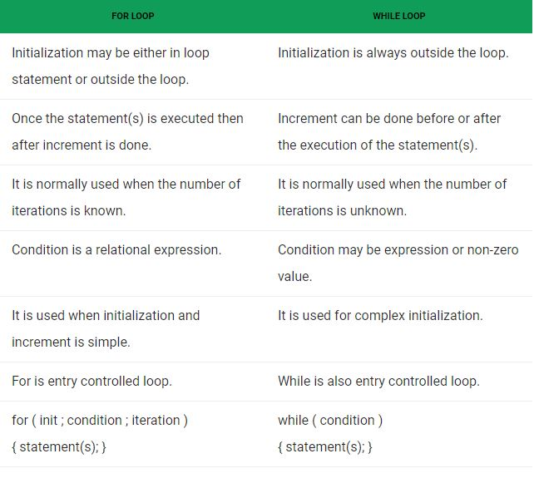
for vs while loop

Slide 28
Nested Loops
Nested loops consist of an outer loop with one or more inner loops.
Eg:
for (i=1;i<=100;i++){
for(j=1;j<=50;j++){
…
}
}
The above loop will run for 100*50 iterations.
Outer loop
Inner loop

Slide 29
Program to print tables up to a given number.
#include<stdio.h>
int main()
{
int i,j,k ;
printf(“Enter a number:”);
scanf(“%d”, &k);
printf(“the tables from 1 to %d: \n”,k);
for(i=1; i<k; i++){
for(j=1; j<=10; j++){
printf(“%d ”,i*j);
} //end inner for loop
printf(“\n”);
} //end outer for loop
return 0;
} //end main
Enter a number
4
The tables from 1 to 4
1 2 3 4 5 6 7 8 9 10
2 4 6 8 10 12 14 16 18 20
3 6 9 12 15 18 21 24 27 30
4 8 12 16 20 24 28 32 36 40
Notes:
K =100
Number: 1 cube: 1
Number:2 cube: 8
Number: 3 cube: 27
Number: 4 cube: 64

Slide 30
Program to display a pattern.
#include<stdio.h>
int main()
{
int i,j;
printf(“Displaying right angled triangle for 5 rows”);
for(i=1 ; i<=5 ; i++) {
for(j=1 ; j<=i ; j++)
printf(“* ”);
printf(“\n”);
}
return 0;
}
Displaying right angled triangle for 5 rows
*
* *
* * *
* * * *
* * * * *

Slide 31
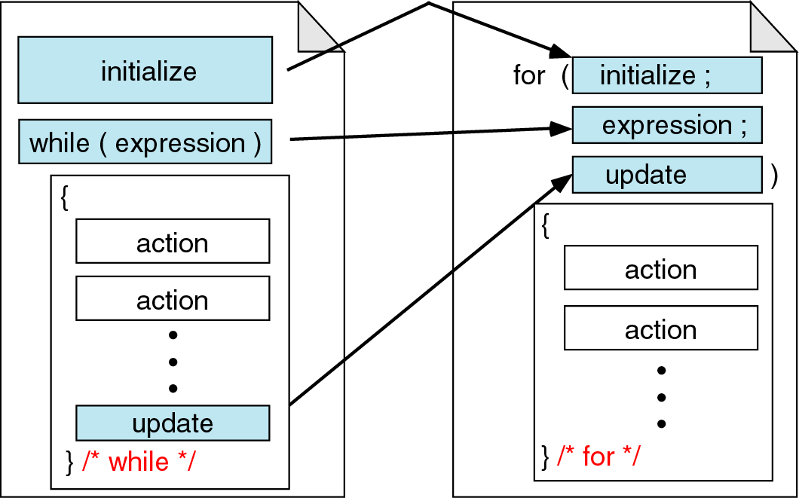
While vs. for statements
Comparing for and while loops

Slide 32
The do-while Statement in C
The syntax of do-while statement in C:
The statement executed at least one time(even if the condition is false)
For second time, If the condition is true, then the statement is repeated else the loop is exited.
Also known as exit-controlled loop, as loop body executes first and then the condition is checked
do
{ statement;
} while (condition);
Syntax

Slide 33
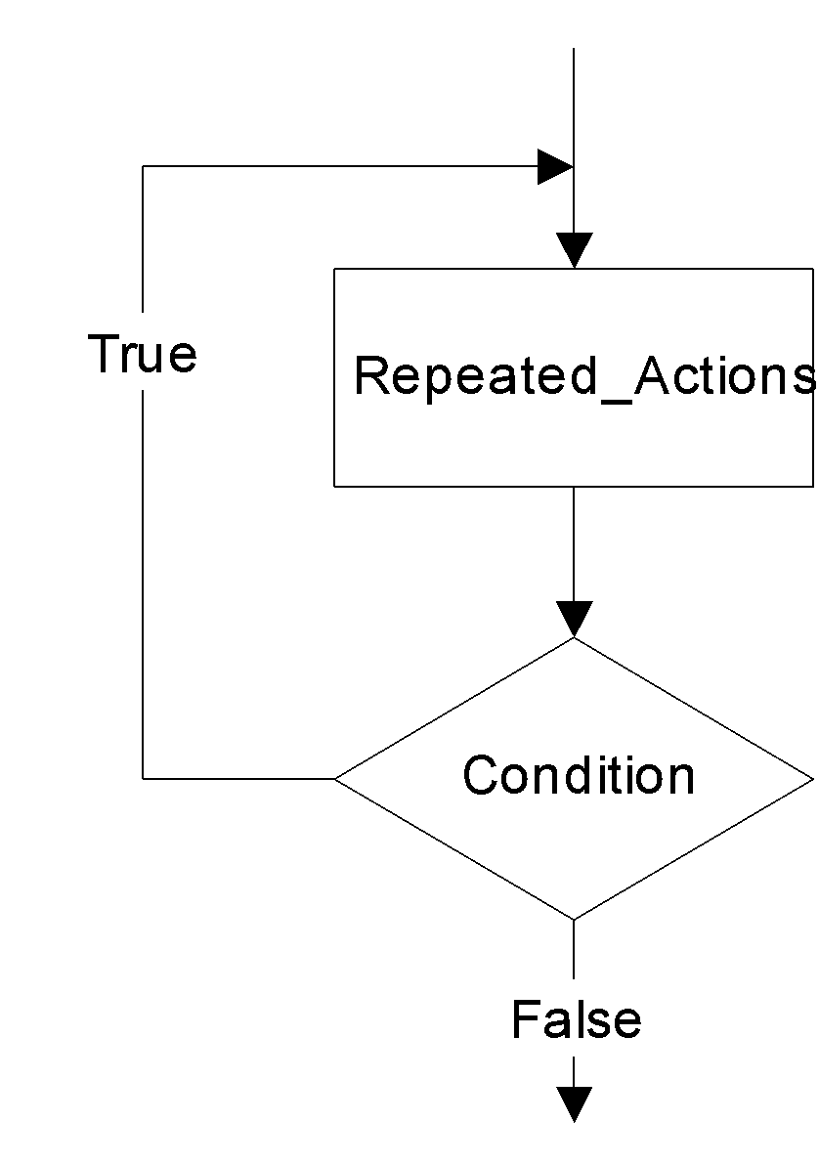
do…while statement
do
{
Repeated_Actions;
} while (Condition);

Slide 34
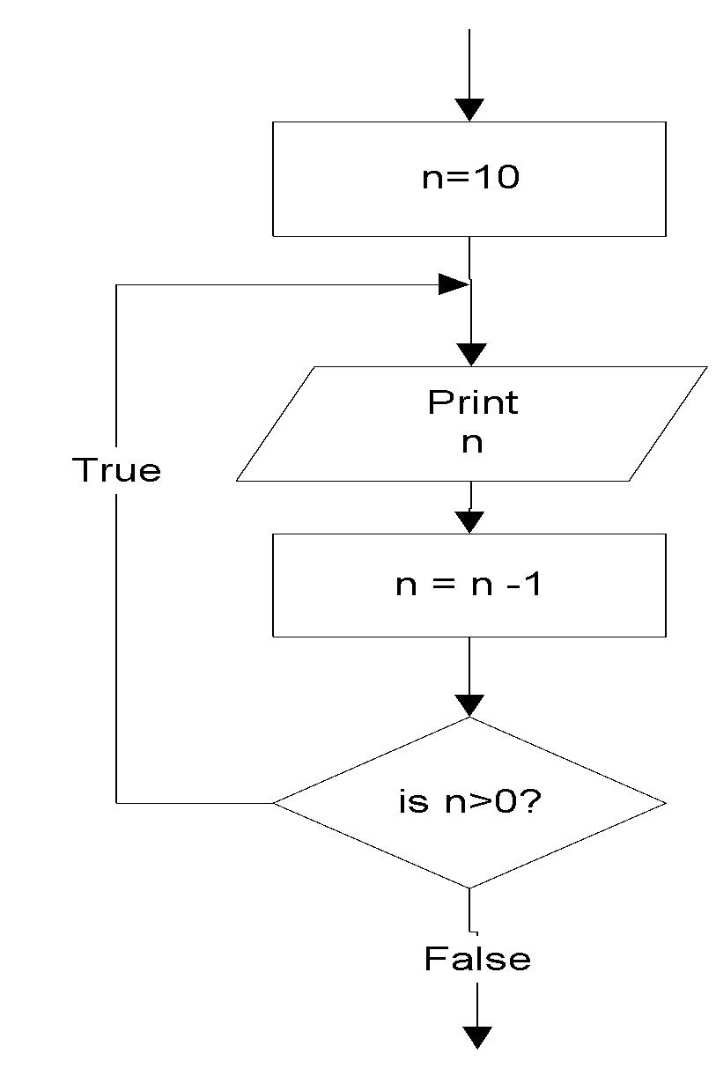
do…while statement
Example: this do…while statement prints numbers 10 down to 1
#include<stdio.h>
int main()
{
int n=10;
do{
printf(“%d ”, n);
n=n-1;
}while (n>0);
}
10 9 8 7 6 5 4 3 2 1

Slide 35
Difference between while and do..while
while loop | do..while loop
1. Condition is specified at the top | 1. Condition is mentioned at the bottom
2. Body statements are executed when the condition is satisfied | 2. Body statements are executed at least once even if the expression value evaluates to false
3. It is an entry controlled loop | 3. It is an exit controlled loop
4.Syntax: while (condition) statement; | 4.Syntax: do { statements; } while (condition);

Slide 36
Q1
What will be the output of the following C code?
#include <stdio.h>
int main()
{
do
printf("In while loop ");
while (0);
printf(“\nAfter loop");
return 0;
}
A. In while loop
B. In while loop
After loop
C. After loop
D. Infinite loop
Notes:
B

Slide 37
Q2
What will be the output of the following C code?
#include <stdio.h>
int main()
{
int i = 0;
do {
i++;
printf("In while loop\n");
} while (i < 3);
return 0;
}
A. In while loop
In while loop
In while loop
B. In while loop
In while loop
C. Nothing will be displayed
D. Compile time error
Notes:
A

Slide 38
Q3
How many times i value is checked in the following C code?
#include <stdio.h>
int main()
{
int i = 0;
do {
i++;
printf("in while loop\n");
} while (i < 3);
return 0;
}
A. 2
B. 3
C. 4
D. 1
Notes:
B

Slide 39
Q4
What will be the output of the following C code?
#include <stdio.h>
int main()
{
int i = 0;
do
{
printf("Hello");
} while (i != 0);
return 0;
}
A. Nothing
B. H is printed infinite times
C. Hello
D. Run time error
Notes:
C

